Slide 1

Predicting Apartment sale prices in Daegu, South Korea
By Danny Hua

Slide 2
Summary
Analyzing real estate data in Daegu, South Korea to create a regression model to help real estate agents improve pricing and potentially yield higher commission.
The data being looked at are apartment real estate transactions that took place from 2007 to 2017.
Descriptive and Inferential statistics analysis were done to identify variables to use for the regression model.
A regression model with an R-Squared of 0.74 was achieved.

Slide 3
More than 74% of the observed variation can be accounted for by the model
Regression Statistics
Multiple R | 0.86
R Square | 0.74
Adjusted R Square | 0.74
Standard Error | 53844.43
Observations | 5891
Size, Terraced Hallway, and 0-5 min from subway are the top 3 variables correlated to sale price
More properties appear to be priced lower around $500K and up

Slide 4
7 variables that showed significant correlation to sale price were chosen for the regression model.
Floor
Which floor the property is located on
Num Basement Parking
Number of parking spots in the basement
Num Amenities
Number of amenities available to the tenants such as a swimming pool, gym, playground, etc.
It does not breakdown the types of amenities available
0-5 min from subway
Categorical data to determine if the property is within 5 min of a subway station
Terraced Hallway
Categorical data to determine if the property has a terraced hallway or not

Slide 5
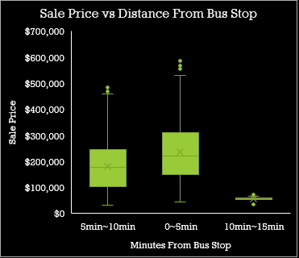
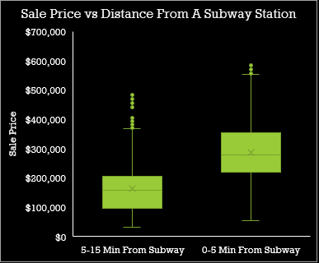
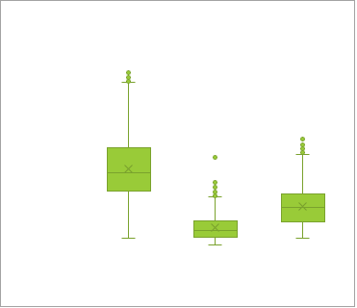
0-5 min from subway (left) and Terraced Hallway (Middle) were the only two categorical variables chosen to be included in the regression model because the box plots and correlation coefficient indicates that there is a strong correlation to sale price
Properties within 5 minutes from a subway have a higher sale price. Properties within 5 min of a bus stop (refer to right graph) shows a slightly higher sale price but not significantly higher. Due to weak correlation to sale price we decided to exclude Distance from Bust Stop.
Sale price for properties with a terraced hallway is significantly higher compared to properties with a corridor or mixed hallway type.

Slide 6
Size and Number of Amenities indicate strong linear relationship to sale price. Both variables also have a correlation greater than 0.5
The more amenities (gym, pool, playground, on-site laundry, etc…) the higher the sale price tends to be
One thing about the Number of Amenities variable that may have been useful is if it breaks down what type of amenities are available
As the size of the property increase we tend to see a higher sale price
What is interesting about the graph is that at a certain size we start to see a decline in sale price
Additional data is required to understand why sale price is lower for homes that have more square feet

Slide 7
Year built, number of basement parking and the Floor the property is located on also displays correlation / linear relationship to sale price
The variables listed here have a correlation coefficient between 0.30 – 0.50
Properties located on the 35th floor and up tends to have a higher price range compared to properties located on lower floors which have a wider price range

Slide 8
Conclusion
A regression model with an R-Squared of 0.74 was achieved and may help real estate agents improve pricing and maximize commission.
Based on our findings, to maximize commission, real estate agents should focus on apartments that are generally large in terms of square feet, is within 5 mins of a subway station, has a terraced hallway and offers several amenities.
If possible, look for apartments located on the 35th floor and up because those properties should not price below $300k according to our data.
The model could further be improved with better data
Number of amenities could be broken out into separate categories instead of adding up the number of amenities. This would allow us to understand if there is a specific type of amenities that are more correlated to sale price
Transforming distance from subway (a categorical data) into a quantitative variable may have been more helpful. Instead of determining if a property is 0-5 min from a subway station, we should measure that distance using meters or miles. This may or may not improve our model, but is something we can test given that the necessary data is available

Slide 9
Start out presentation with exploratory
Think big picture
Don’t jump to conclusion
Think of setting up slide deck as story to tell to stake holders
Include a grabber

